Slide 1
MS/HS ELA Collaborative
April 21, 2015
Notes:
Bring binders/books for new attendees.
Lunch: 11:30ish
Hand signal to bring group back together.

Slide 2
What’s Important?
Bill Gates, Carlos Slim Helu family, Warren Buffett, Amancio Ortega, Larry Ellison
Marcus Mariota, Jameis Winston, Johnny Manziel, Robert Griffin III, Cam Newton
Kira Kazantsev, Nina Davuluri, Mallory Hagan, Laura Kaeppeler, Teresa Scanlon
Kailash Satyarthi & Malala Yousafzai, Organization for Prohibition of Chemical Weapons, European Union, Ellen Sirleaf, Leymah Gbowee & Tawakko Karman, Liu Xiaobo
Notes:
10 minutes
Take the following quiz:
Name the 5 wealthiest people in the world.
Name the last five Heisman trophy winners.
Name the last 5 winners of the Miss America contest.
Name 10 people who have won the Nobel Prize.
How did you do? The point is, none of us remember the headlines of yesterday. These are no second-rate achievers. They are the best in their fields. But the applause dies, awards tarnish, achievements are forgotten, accolades and certificates are buried with their owners.

Slide 3
Here’s another quiz!
Notes:
5 minutes
List a few teachers who aided your journey through school.
Name 3 friends who have helped you through a difficult time.
Name 5 people who have taught you something worthwhile.
Think of a few people who have made you feel appreciated and special.
Name half a dozen heroes whose stories have inspired you.
Is this easier? The lesson…the people who make a difference in your life are not the ones with the most credentials, the most money, or the most awards. They are the ones that care.

Slide 4
Learning Targets
I can prepare my students for the M-Step and SAT assessments.
I can create and use Text Dependent Questions with my students to promote close reading.
I know how to use text sets to offer multiple entry points for students, and provide for a deep and sustained engagement in reading and thinking.
I can promote summer reading in my classroom and building.
Notes:
Insert learning targets for the day. Ask Matt to share one.
Which LT do you connect to the most? Share with an elbow partner.

Slide 5
Agenda
Introduction
Adolescent Literacy: Matt Norcross, McLean & Eakin
M-Step
SAT
Text Dependent Questions
Close Reading
Summer Reading

Slide 6
Matt Norcross, McLean & Eakin Books
"We read to train the mind,
to fill the mind,
to rest the mind,
to recreate the mind,
or to escape the mind.”
~ Holbrook Jackson
Notes:
45 minutes
Check with Matt to see if the morning works best for him? Also, find out his topic and how much time he needs.

Slide 7
M-Step Debrief
What were some challenges you encountered and how did you overcome them? (students, teachers, technology, etc.)
What specific tools and strategies did you use to prepare students for this type of assessment?
How did the testing schedule affect teaching and learning in your building?
Notes:
Refer to Walkabout handout. Walkabout refers to a rite of passage during which male Australian Aborigines would undergo a journey during adolescence and live in the wilderness for a period as long as six months.
Take time to fill out the answers to the three questions. Then, get up and find another person and exchange responses. Return to seat when finished with your walkabout.

Slide 8
Spotlight on Assessment and Accountability
M-Step resources

Slide 9
SAT
SAT and Michigan
Khan Academy
Reading sample questions
Writing and language sample questions
Essay sample prompts
Notes:
Review the “Key Content Changes” document and discuss as a group.
Go to SAT/Michigan (SAT: Scholastic Assessment Test) website and click on “Prepare” on left side of screen.
Choose 3 different stickers to put on outside of folder to indicate groups (something fun). Each group member will read the assigned section on the website and use the note taker to collect important information (key vocabulary, Aha! Moments, and implications for instruction).
Meet as a group and create a poster that encompasses your learning. Elect a spokesperson and share with whole group.
.
Writing and Language (22 questions)
Reading (24 questions)
Essay prompt (sample essays given)
*Have each group create a poster summarizing what they learned and share with whole group.
Review the Khan Academy SAT site with teachers.

Slide 10
Professional Read
“Text Dependent Questions”
Notes:
Use Fisher and Frey article on Text Dependent Questions.

Slide 11
Close Reading
Text Dependent Questions
What does it say?
General understandings and key details
How does it say it?
Vocabulary, text structure, and author’s craft
What does the text mean?
Author’s purpose, inferential questions, and intertextual questions
What does it inspire me to do? What does it mean to me?
Opinion with evidence or argument
Notes:
Fisher: p. 19…When a group of researchers examined the time it took for people to develop fairly simple habits (self-selected ones such as drinking more water each day or doing sit-ups before breakfast), they found that the average number of repetitions required was 66 before the person reached a plateau. They found that:
Missing a single day did not reduce the chance of forming a habit.
A subgroup took much longer than the others to form their habits, perhaps suggesting some people are habit resistant
Other types of more complex habits may well take much longer
Students aren’t likely to develop the habit of close reading very quickly.
Refer teachers to Close and Critical Reading bookmarks.

Slide 12
Salient Features
Short, complex passage
Repeated readings
Annotation
Collaborative conversations
Text-dependent questions
Notes:
What are the building blocks of effective close and critical reading lessons? (Fisher and Frey)
These are scaffolds students need to understand the text.
The text is a few paragraphs to a few pages in length. It is sufficiently complex for multiple readings. It is a challenge to readers’ thinking and understanding.
Students reread as a primary scaffold for understanding, with appropriate guidance and support, for different purposes, to find evidence for inferences and conclusions. Some benefits of repeated readings are that students engage in collaborative conversations, students dig more deeply into the meaning, students improve their fluency and comprehension.
Annotation allows students to slow down their reading of print of digital text, write directly on the text, identify central ideas, circle confusing words or phrases, write margin notes, discuss the text with others.
Collaborative conversations provide interaction with peers and teachers, use academic language, facilitate one another’s understanding. Fisher and Frey do not define students reading hard texts individually and independently and then answering questions as close reading.
TDQs strategically focus student attention on challenging or confusing parts of the text, center on various aspects of the text (structure, meaning, logical inferences that can be drawn from the text), require evidence from the text.

Slide 13
Progression of Text-dependent Questions
Opinions, Arguments,
Intertextual Connections
Inferences
Author’s Purpose
Vocab & Text Structure
Key Details
General Understandings
Whole
Across texts
Entire text
Segments
Paragraph
Sentence
Word
Part
Notes:
Think about the four levels of close and critical reading.

Slide 14
Progression of Text-dependent Questions
Opinions, Arguments,
Intertextual Connections
Inferences
Author’s Purpose
Vocab & Text Structure
Key Details
General Understandings
Whole
Standards
8 & 9
Across texts
3 & 7
Entire text
6
Segments
4 & 5
Paragraph
2
Sentence
Word
1
Part

Slide 15
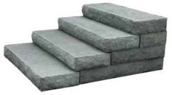
Text-Dependent Questions:
4 Levels of Close Reading
Level 1: What does the text say? (Standards 1,2,3,10)
Level 2: How does the text work? (Standards 4,5,6,10 )
Level 3: What does the text mean? (Standards 7,8,9,10)
Level 4: What does the text inspire you to do? (Standards 7,8,9,10)
“Text-Dependent Questions prepared for a series of discussions about a compelling text serve the important purpose of setting some trail markers for the guide and the travelers to follow,” (Fischer and Frey, 2015).
Notes:
Collectively, these guiding questions provide a means for addressing close and critical reading.
In addition, they are a method for addressing all the reading standards, as well as significant portions of the language, speaking and listening, and writing domain standards outlined in the CCSS documents.
Over time, and with practice, students will ask themselves and their peers these questions as they engage with complex texts.

Slide 16
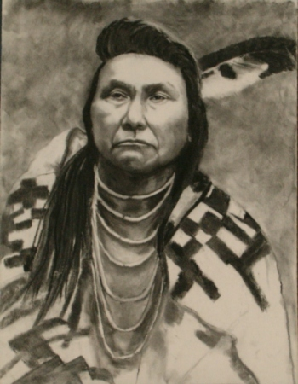
“Melting Pot” Anna Quindlen
Notes:
Let’s look at Doug Fisher modeling a close reading lesson using Text Dependent Questions.
Video is hyperlinked from picture. Maybe add follow up slides to show how he scaffolded questions.

Slide 17
TDQ Sort “The Tell-Tale Heart”
Notes:
p. 220, “The Tell-Tale Heart” lesson. Patti has template for sort.
Cut apart questions and sort under the 4 levels using template provided.

Slide 18
Develop Text-dependent Questions for Your Reading
Do the questions require the reader to return to the text?
Do the questions require the reader to use evidence to support his or her ideas or claims?
Do the questions move from text-explicit to text-implicit knowledge?
Are there questions that require the reader to analyze, evaluate, and create?
Notes:
“Melting Pot” by Anna Quindlen. Have them develop questions and then compare to Doug’s.
Resources that will help: mining the potential of narrative/informational text mats, TDQ sentence stems for each standard.
Show bookmarks on weebly by grade level. Maybe have some sample bookmarks on each table to preview????

Slide 19
The Role of Background Knowledge and Close Reading
Close reading, then, should not imply that we ignore the reader’s experience and attend closely to the text and nothing else. It should imply that we bring the text and the reader close together.
Notes:
Show “Bookmark” resources by grade level.

Slide 20
Texts and Lessons
Notes:
Model how to use a text set (Labels, p. 250). Show connection between this type of study and a performance task? Could walk through one in the book and then work on building your own.
Also, put out list of reading/writing standards and highlight which ones are addressed through the text set lesson. How could we adapt to incorporate writing standards?

Slide 21
Notes:
Place copies of Sara Holbrook’s poem, “Labels” on large sheets of chart paper.
Today we are going to have another kind of literature discussion—a silent, written conversation about a poem, in groups of three. You can see that we have these large sheets of paper with a poem in the middle of each one. When we are ready to start, you’ll grab your own color marker and write your thoughts about the poem in the margins. Jot a few of your own thoughts and reactions, start reading what your partners have been writing in the margins. Now you can engage in a silent discussion by writing notes to your friends about their ideas. You can comment, react, compare of ask them questions. We want a lively conversation to break out right in the margins.
Read the text aloud first, and then you can let them go to work studying the poem and writing about it in the margins.
Give instructions for conversation. Have students make a “map key” in the corner of the page that shows who’s writing with which color pen. Use the “Things to Think About While Reading” to help you annotate.Since this is a poem, pay attention to the poetic forms, tools, or techniques that the author uses.
Gallery Walk: Have groups travel around, visiting other posters, taking notes about how these other conversations were alike and different from their own. Then these ideas can be shared in a whole group meeting/discussion.

Slide 22
Notes:
Get out a sheet of paper and we’re going to “read” an image for 30 seconds. As you concentrate on the painting, I want you to try and memorize as many details as possible. When the time is up, I will remove the image and give you a quiz.
Project the image for 30 seconds. After time is up, remove the image.

Slide 23
How many people are in the piece?
How would you describe them?
How is each one dressed?
What do people do for a living?
What kind of setting is depicted? Where do these people live?
What colors do you remember in the setting?
What kind of feelings do you get from the setting: tidy, chaotic, calm? Those are just examples.
What is this piece about?
What’s the overall feeling you got looking at this piece?
Notes:
Memory note taking: Now I want you to write down everything you remember related to the prompts on the slide.
Pairs meet and spend a couple of minutes comparing what they jotted down. Pay particular attention to details one person remembered that the other didn’t. That’s why we always work together. Different people notice different things and bring different ideas to the table. Listening to what others think expands our own thinking.
Project the image again. Using the image and your notes, I want you to think about the story this piece is telling and the impression the artist is trying to give the viewer about the story. What artistic choices did the painter make to shape the depiction?
Categorize your details on a Venn diagram using these labels: left circle—reality; right circle—stereotype. Leave the intersecting section blank for now.

Slide 24
Sure You Can Ask Me a Personal Question Diane Burns
Notes:
Students read the poem “Sure You Can Ask Me a Personal Question
During reading, mark lines that they think make connections with “Sitting Bull Returns” at the Drive-In.
Step one: Preparation
Identify a reading or video excerpt that will serve as the catalyst for this activity.
Step two: Students read and respond to text
Have students read or view the selected text. Ask students to highlight three sentences that particularly stood out for them and write each sentence on the front of an index card. On the back they should write a few sentences explaining why they chose that quote - what it meant to them, reminded them of, etc. They may have connected it to something that happened to them in their own life, to a film or book they saw or read, or to something that happened in history or is happening in current events.
Step three: Sharing in small groups
Divide the students into groups of three, labeling one student A, one B, and the other C. Invite “A”s to read one of their chosen quotations. Then students B and C discuss the quotation. What do they think it means? Why do they think these words might be important? To whom? After several minutes, as the A students to read the back of their cards (or to explain why they picked the quotation), thus having “the last word.” This process continues with the B student sharing and then student C.
After discussion of poem, groups decide what feelings or messages the art and poem share. Students then jot notes in the middle section of the Venn.

Slide 25
Notes:
Tell students they will be reading the speech of a college student in fear of being deported. Have students read Mandeep Chahal’s speech on being “a dreamer” twice. On the second reading, they should underline the words and phrases they would emphasize if they were giving the speech as well as the places they would pause when they really wanted to give the audience time for the message to sink in.
Have students share their interpretation with a partner and then watch the speech.
Ask volunteers to compare Chahal’s interpretation to the notes they took during reading.

Slide 26
“On Making Him a Good Man by Calling Him a Good Man” Dave Eggers
Can we influence those around us by the way we label them?
Notes:
Offer students this guiding question before they begin reading: Can we influence those around us by the way we label them?

Slide 27
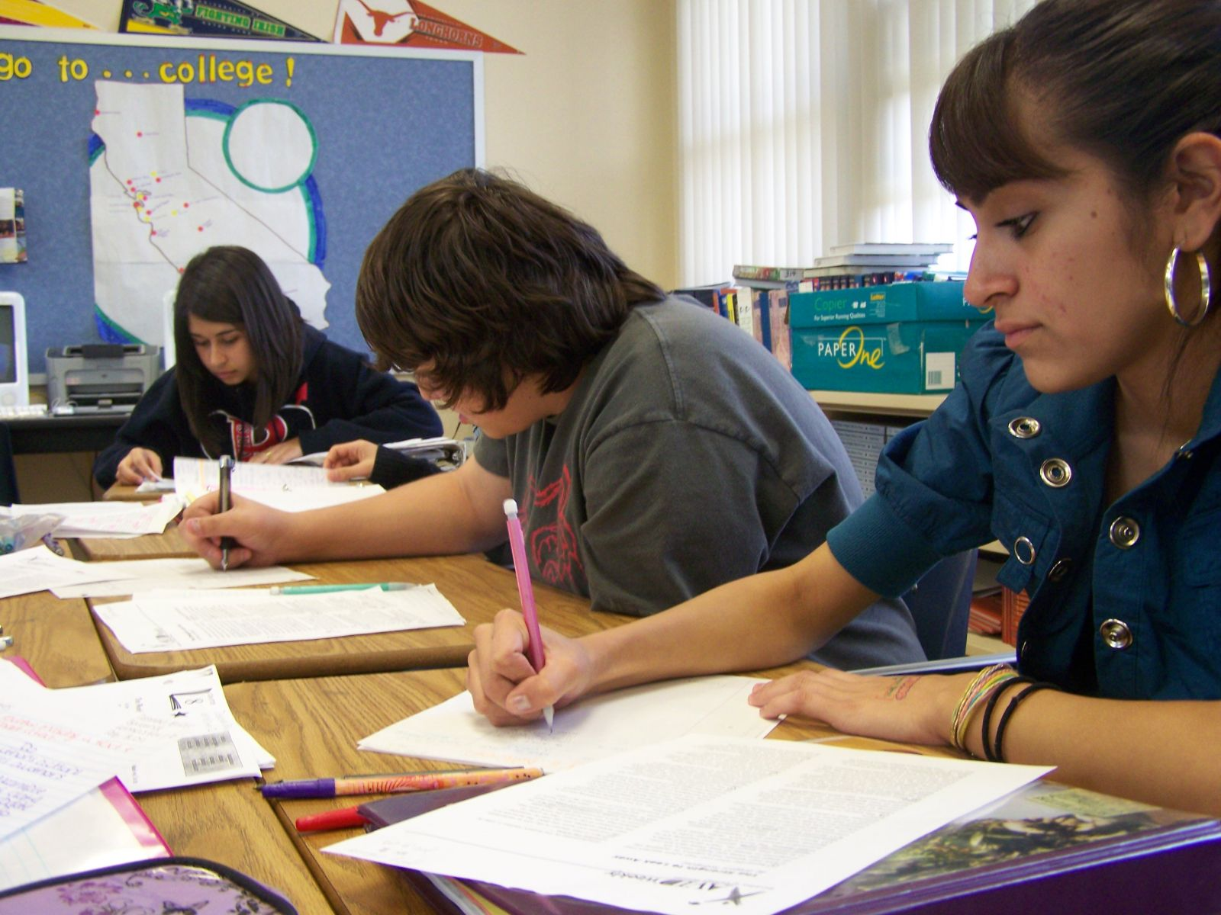
Written Conversation
Pulling from all these texts, do you think a community can help its members become better people by viewing each other and speaking about each other more positively?
Notes:
Using the CCSS document: highlight the standards that would be supported through teaching these texts?
Look at the criteria for a performance task, how do the readings and tasks support the PT?
Variations: at your table, discuss how culminating activity could be amended to include more writing standards.

Slide 28
Performance Task Resources
CORE ELA Performance Assessment Modules
MDE Sample Performance Tasks
Reading and Writing Project Common Core Aligned Assessments

Slide 29
Summer Reading
Notes:
Review summer reading presentation and share ideas.

Slide 30
Looking Ahead…
Summer Institute
Book Study
Classroom Observations?
Notes:
Summer Institute, 5D PD, next year’s format and book study????( Kelly Gallagher’s new book)

