Slide 1
MS/HS ELA Collaborative
December 3, 2014
Notes:
Put working agreements on table tents.

Slide 2
Stomach: What gives you indigestion?
Head: What drives you crazy?
Heart: What you love
Leg: What you bring
Hand: What you want to let go
Hand: What you want to take away
Notes:
Find the ginger bread man/woman template on your table. Each person takes a turn introducing themselves and choosing one response. They can write in the answers on the template, put their names on it and post.

Slide 3
Notes:
Before reading book aloud, invite each teacher to write their dream for their students OR why they were inspired to enter the teaching profession in the first place. Fill in the information on the star template in folder. Set aside as I read aloud the book.
What is our journey as an educator?
What did the author mean when he wrote “The beginning” at the end?
What are the similarities we share, and how are we each unique?
As we segue into an assessment update, remember that what is most important is our role and purpose in the classroom. While others focus on how to weigh the elephant…WE FEED IT!

Slide 4
Feedback on your feedback
Notes:
Summarize feedback on graphic organizers and explain how it was used to plan for the day.

Slide 5
Purpose Statement: Draft 1
We meet as a professional collaborative group to explore research and evidence based literacy strategies, examine current research to positively impact our practice, and share digital and print resources that support implementation of the CCSS for ELA.
Notes:
You wanted it to say “face to face” as that was important to the group. You also asked that it not focus on things we can do independently…emphasize building shared understanding.

Slide 6
Purpose Statement: Draft 2
We meet face-to-face as a professional collaborative to share expertise, examine data, and mutually support one another. This group allows us an opportunity to explore instructional practices that positively impact student achievement while receiving continual feedback from our peers. We will strive to understand the new teacher evaluation system and better understand how we can show student growth.
Notes:
Show draft #2 and ask for final revisions.

Slide 7
Assessment Update
Notes:
M-Step update: Assessment Transition
In small groups of 4, use the following protocol:
(Put stickers on Spring 2015 Michigan Statewide Assessment Transition” document to indicate which group member reads which section).
Using the “Here’s What. So What? Now What? Protocol” have small groups share the facts, interpretations and questions they have about their assigned section. Have each group come to consensus on 3-5 factual statements, interpretations, and questions they would like to bring to the whole group.
During whole group share out, compile information on chart paper, especially relevant questions

Slide 8
Overview
Test Session Timing AND Online Assessment Sequence
Classroom Activity
Pages 7-8
Notes:
Everyone should take a look at the testing calendar on the last page.

Slide 9
ACT Resources
www.noredink.com
www.number2.com

Slide 10
Break
Notes:
10 minute break

Slide 11
Notes:
Highlights from conference…

Slide 13
Models that Drive Better Writing
Notes:
Finding models and mentor texts: should not come from only us. We need a balance. Give them strong models to emulate and then you go…then they go. He suggests that you read a lot of literature at the grade level you teach and find excerpts. Look for them every time you read.
Looping: helps you discover a topic you might want to write about. It’s different from a mentor text, side by side writing. This represents a different kind of modeling. You take a line from a poem and use that to spur your thinking. Then you select a line from your writing, and loop again. Out of everything you generate, you pick something to write about.

Slide 14
Notes:
You tube version of poem is hyperlinked. We can listen as we read along.
Circle words/phrases/sentences that are “hotspots”
Look back at what you’ve circled and commit to watering one of these seeds. We are going to do three 8 minute loops

Slide 15
http://www.online-stopwatch.com/countdown/
Notes:
Set timer for 8 minutes
Look at the three loops and find something you want to write about. Can be a spoken poem, essay, whatever. Give them 20 minutes to write.

Slide 16
https://www.youtube.com/watch?v=a1oKs8fvYQg
Notes:
We need models. Sometimes we have to redo them. You don’t want to look like a guy with a short tie!

Slide 17
Put Your 1st Draft Under the Radar
Notes:
The idea is to “move the paper and make it better”
Refer to RADAR handout
Let’s look at our draft from the looping exercise and move it into revision. Give them 15-20 minutes to revise their piece.
Give teachers time to revise

Slide 18
Break
Please share your draft with me and I will make copies for your writing group.
Notes:
For groups of 4, I will need to make 3 copies of the original piece.

Slide 19
Writing Groups
Distribute copy of draft to each member.
Person sharing determines level of response and distributes squares of paper.
Read paper aloud. Group listens with pen in hand taking notes around level requested.
Group members take turns reading comments, while writer listens.
Notes:
Came out of NWP. His kids meet every Thursday. Each student brings something for the rest of the group to look at (newly drafted or newly revised). Most weeks, he does not determine the topic.
Once about every 6 weeks, he does have them do a common write. He does not do writing groups the first ¼ of the year. Takes time to establish relationships with students and among students. Once they are comfortable speaking and sharing, he forms groups. He mixes gender, puts reluctant writers with nurturing students, mixes ability levels. Occasionally you may need to shirt writing groups because they don’t work. At the onset, he shows them portfolio requirements for the end of the year (argument, poem, writing from another class, etc). That way, if you notice a kid bringing a poem every week, you can reference the portfolio requirements. Could say, “Why don’t you turn that poem into an argument piece? He has 52 minutes per period.
Uses groups of 5. For frequent absentees, he puts 6 in that group.
Some kids won’t bring anything. They don’t get credit. He stamps instead of grades. 3 strikes rule. If you don’t bring something 3 weeks in a row, you threaten to take them out of the group and then they work along. One rule doesn’t work for every kid…you have to judge and nudge.
He mandates that group members say thank you after each person reads. He builds this in first quarter. Writing can be fun for an audience beyond the teacher. Always ends with an Author’s Chair experience.

Slide 20
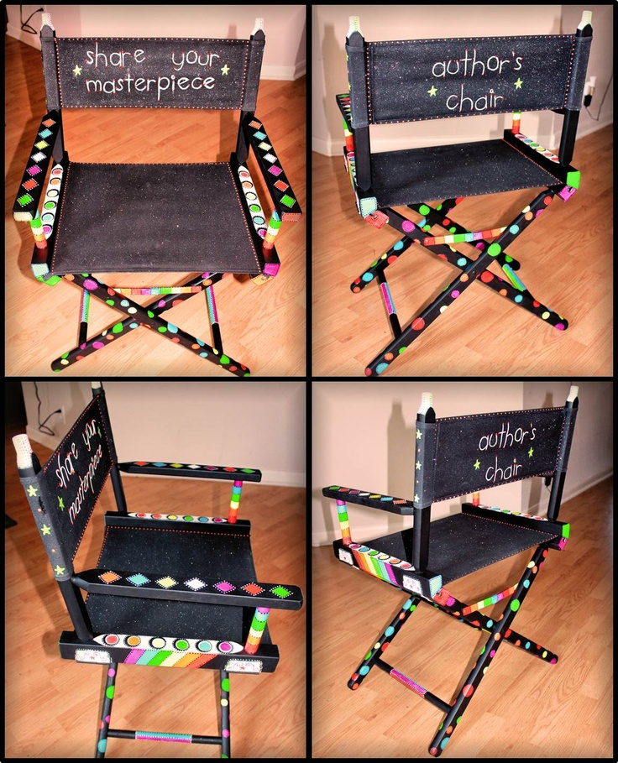
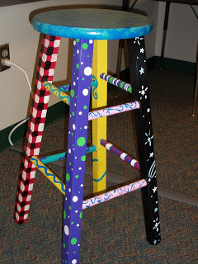
Author’s Chair
Notes:
Would anyone like to share their draft with us?
Bring in a chair☺

Slide 21
Reflection Time
Notes:
Put reflection questions on notecards in envelopes for small groups to discuss.
What worked? What did not work?
How might writing groups work in your classroom? What tweaks would you make?
How might writing groups fit in with your system’s schedule/expectations?
What are the obstacles to forming writing groups and how can they be overcome?
What alternatives to writing groups might be employed to get kids to write more?
Look at the squares of paper…which would make my paper better? Shows them comments like: Love it! Vs I love your intentional repetition…use this more.
Doesn’t believe in peer editing. Designates kids in the class as peer editors (3-4). In the interest of time, have prolific writers choose an excerpt (no more than 2 pages) to writing group. You WILL have kids bring in chapters. They are required to write 5 pages per week in notebook. He sometimes does a fluency writing test…write for five minutes on….
Typically, a HS student can write 1 page in 5 minutes. MS students should be able to write 2 pages in 20 minutes. Are you building your endurance as a writer?

Slide 22
What worked? What was a challenge?
How might you use writing groups in your classroom? What tweaks would you make?
How might writing groups fit in with your system’s schedule/expectations?
What are the obstacles to forming writing groups and how can they be overcome?
What alternatives to writing groups might be employed to get kids to write more?

Slide 23
Teaching Argumentation
Notes:
We have been building our “Argument Writing” toolbox and here is another strategy to add!
Need 25 tokens for each teacher, plastic cups, blank bingo board, list of claims, list of textual evidence, note taker.
Play with To Kill A Mockingbird sample.

Slide 24
Writing Prompts
Notes:
Show hyperlink to “500 Prompts for narrative/personal writing” resource. This is a companion to the “200 Argument Writing Prompts” resource we used at the last collaborative meeting.

Slide 25
Close Reading
Notes:
Split into two groups.
Use “The Success Analysis Protocol” to guide sharing time within each group.
Whole group: share out lingering concerns or share a success that everyone needs to hear!

Slide 26
Independent Reading Resources
Notes:
Share the handouts from Penny Kittle…how might you utilize these resources during Independent Reading time?
Penny says that we must balance close reading with independent reading. If choosing for them worked, then more kids should be successful.

Slide 27
Amping up Annotations!
Notes:
Put individual lines of text around the room (students move every 3-4 minutes).
Discuss how this type of annotation forces them to dig deeper because the surface level annotations are done first.

Slide 28
Metacognitive Funnel
Notes:
Give each group a section of the poem and have them categorize the annotations as: Notice Thinking, Focus on Reading, Focus on Solving Reading Problems, or a Focus on Disciplinary Literacy Practices.
Provide each group with a blank funnel graphic organizer and then either place sticky notes/annotations in the proper place.

Slide 29
Time to Explore!
Notes:
Generate some topics that teachers would like to share, research, etc.
It could be grade level teams, building teams, or like-interested people collaborating!

Slide 30
Gots and Needs

Slide 31
Brightest Stars
Teachers are Among the Brightest Stars in Our Constellation.
They guide us, Inspire Us.
They light the way, They help us see patterns in the stars.
They are there even when the clouds roll in, Teachers are around us, their spirit surrounds us, twenty four hours a day.
They help us find true north.
They help us navigate our way to our true potential.
They are stars.
They are among the brightest stars in our constellation.
*Peter Reynolds*

