Slide 1
ELA collaborative
Grades 6-12
February 21, 2013
8:30-3:30

Slide 2
Notes:
Choose a penny with a year that you were alive and can remember.
If you don’t want to remember that year, you may “flex” it one year or another.
Take out a sheet of paper and write the year at the top. Underneath the year, write:
-Where you lived
-The car that you drove
-Memorable events (meet the love of your life, get married, have a child…)
-Take a vacation?
-Significant local, national, or international events?
Go around the room and share their name, position, background the collaborative, the year of their penny, and one thing from their list.
Do a Quick write on how the activity connects with writing.
-All writing is based on personal experience (b/c it is their synthesis and analysis of a situation)
-Ideas with details reflected our voice b/c we got an essence of who we are with the sharing
-Received feedback from the audience
-The sharing sparked other ideas that we maybe hadn’t thought of (collaboration)
-We read it out loud which was like peer-revision
-Flexibility was built in around the prompt.

Slide 3
“Wise methods of teaching do not come from our genes alone, but from our communities of practice.”
-Lucy Calkins
Notes:
Big Idea: individually, we may just be a single penny, but together we have tremendous value!

Slide 4
Focus
10 Things Every Writer Needs to Know
Common Core State Standards
MAISA Writing Units
Smarter Balanced Assessment components

Slide 5

Text Rendering
Take time to read the article and mark the sentence, the phrase, and the word that you think is particularly important for our work.
  First Round: Each person shares their sentence.
  Second Round: Each person shares their phrase.
  Third Round: Each person shares the word.
Notes:
Carol Jago article
The group discusses what they heard and what it says about the document.
The group shares the words that emerged and any new insights about the document.
The group debriefs the text rendering experience.

Slide 6
Claims Jigsaw
Claim #1, “Students can read closely and analytically to comprehend a range of increasingly complex literary and informational texts.”
Claim #2, “Students can produce effective and well-grounded writing for a range of purposes and audiences.”
Claim #3, “Students can employ effective speaking and listening skills for a range of purposes and audiences.”
Claim #4, “Students can engage in research/inquiry to investigate topics and to analyze, integrate, and present information.”
Notes:
Fix the colored dots
Put stickers on outside of folders to correspond with groups. Put packets of claim information on chairs and have group members get their packet for the activity.
Hand out the “goody bags” with the visual reminders of what each claim represents.

Slide 7
Expert Groups
Form Instructional Strategy Groups (all blues, greens, reds and yellows together)
Work collaboratively to master content and clarify understanding.
Notes:
Need 20 minute slide

Slide 8
Home Base Group
Form groups of 4 with each person having read a different ELA/Literacy Claim.
Present segment to group. Others listen, ask questions to clarify, and take notes.
Notes:
Need 20 minute slide

Slide 9




Claim #1:
Claim #2:
Claim #3:
Claim #4:

Slide 10
NGAP
Opportunity to experience the Smarter Balanced Assessment Consortium items on computers.
Provides educators and students with insight related to the upcoming assessments.
Notes:
See if Tim Davis can get those signed up enrolled to log onto modules.

Slide 11
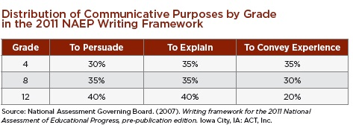
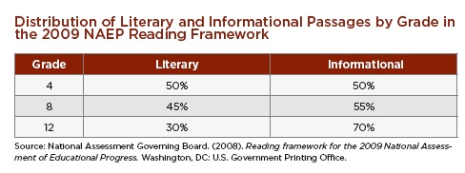
NAEP CHARTS
11

Slide 12

“The Write Way” by Douglas Reeves
If “nonfiction writing is the backbone of successful literacy and student achievement strategy” how would you describe the overall writing health of your building?
Notes:
Put tea party activity here
Independently, read the article

Slide 13
Tea Party
Share cards with as many classmates as possible.
Listen to others as they read.
Discuss how cards might be related.
Speculate on what cards, collectively, might be about.
Notes:
Use the, “The Write Way” article
Table groups: on chart paper, write, “We think…” Make a prediction.

Slide 14

http://www.online-stopwatch.com/full-screen-stopwatch/
Notes:
Set timer for three minutes.

Slide 15

Informational Reading Standards
Notes:
Copy pgs. 39-40 of CCSS for teachers.
Circle every strand.
Highlight words that show progression in skill/difficulty as you progress through the grades
Place a star next to the most challenging standard within each strand.
Underline the standard that you think your building needs to focus on the most within each strand.

Slide 16

www.booksource.com
Notes:
Can search by CC Curriculum map bundles
CCSS Exemplar text bundles

Slide 17
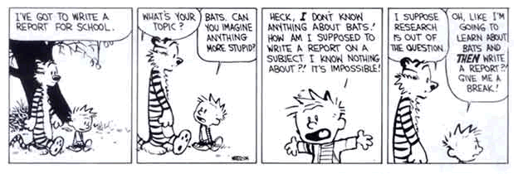
Informational Writing Standards
Notes:
Copy p. 42-47 in CCSS document.
Circle every strand.
Highlight words that show progression in skill/difficulty as you progress through the grades
Place a star next to the most challenging standard within each strand.
Underline the standard that you think your building needs to focus on the most within each strand

Slide 18
Informational Text Exemplars
Locate the appropriate grade band exemplars and read through the texts and performance tasks.
With a partner, complete the Here’s What/So What portions of the Analysis Chart
Here’s What! | So What? | Now What?
Observations & Important Facts | Implications for the classroom | Action steps-what can be done to shift to these standards?
Notes:
Distribute grades 6-8, 9-10, and/or 11-CCR Informational Text Exemplars and performance tasks.
How Do We Do It?
Unpack the Standards for Literacy in History/Social Studies, Science & Technical Subjects
Work through the Sample Performance Tasks for Informational Texts in Appendix B
Analyze current practice, then shift to align to CCSS
“Bloom” up your assessments

Slide 19

Informational Writing Flipbook
www.missionliteracy.com
Notes:
Do a treasure hunt activity with the flipbooks to familiarize teachers with the language of the standards. Need to print out copies of the flipbook and treasure hunt sheet.

Slide 20
Student Writing Samples
Working with a partner at the same grade level, examine the Informational writing sample from Appendix C.
Assign a recorder for your group.
Create a T chart and draw conclusions about the student work:
What do these students know? | What can these students do?
Notes:
Will need to copy examples and standards for annotating. Maybe use the elements from the flipbook to help guide work on the T-chart.

Slide 21
Looking at student work
Is there a difference between the work currently being produced in your school at this grade level and the student work in the
Appendix C of the CCSS? If so, what is it?
What are the implications for our practice?
Notes:
Name the gap that exists between where students should be and where they are currently.
What does this mean for our current practice?
How can we change what we are doing to ensure that students can meet the expectations of the CCSS?
Current and ideal state: (each table has poster paper on which they need to record their conversation in terms of current and ideal state).
1. What is the current state of student and teacher practice if our students are going to produce work such as this?
2. How do we do our jobs now and how will our jobs need to change?

Slide 22

MAISA Units
http://tinyurl.com/MAISAunit
Notes:
Why use the MAISA units?
Aligned to the CCSS
MDE supported
SBAC supported
Half of the units are informational
You can run your leg of the race without looking back!
Workshop model embedded in the units.

Slide 23
Setting the bar high
Writing Standard 5 describes the writing process, and
Standard 10 describes the need to write routinely as part of that process. Without these two standards, the other standards will be difficult to achieve.
Notes:
Get Pathways to the Common Core book for Lucy’s analogy…

Slide 24
Writing workshop structure
Lesson template is from research based on effective instruction

Slide 25
Clear Teaching Points
Modeling/Demonstrating
Guided Practice
Checking For Understanding
Notes:
As summarized by Mike Schmoker 2011 in FOCUS: Elevating the Essentials to Radically Improve Student Learning.
These are the “instructional moves” that are embedded.

Slide 26
Mini-lesson
Short and Simple
Teacher demonstrates a skill or strategy
Collaborative Engagement
Expectations are clear

Slide 27

What, why, and how of writing through mini lesson
What?
  Write through the mini lesson with two perspectives:
    Teacher eyes
    Writer eyes

Slide 28
Why?
  Teachers should write so they understand the process of writing from within.
        Excerpt from Donald Murray,
        A Writer Teaches Writing, 2003

Slide 29
Why?
“Teachers should write, first of all, because it is fun. It is a satisfying activity that extends both the brain and the soul. It stimulates the intellect, deepens the experience of living, and is good therapy. Teachers should write so they understand the process of writing from within. They should know the territory intellectually and emotionally: how you have to think to write, how you feel when writing.
Teachers of writing do not have to be great writers, but they should have frequent and recent experience in writing. If you experience the despair, the joy, the failure, the success, the work, the fun, the drudgery, the surprise of writing you will be able to understand the composing experiences of your students and therefore help them understand how they are learning to write.”
Donald Murray,
A Writer Teaches Writing 2003

Slide 30

Ink your think
Take a moment and write a response to Donald Murray’s quote.

Slide 31

Notes:
Model launching mini lesson from 7th grade unit (p. 17-18).

Slide 32
reflection
Turn to a partner and respond to these prompts:
  What did you notice about this mini lesson as a writer?
  What did you notice about this mini lesson as a teacher?

Slide 33
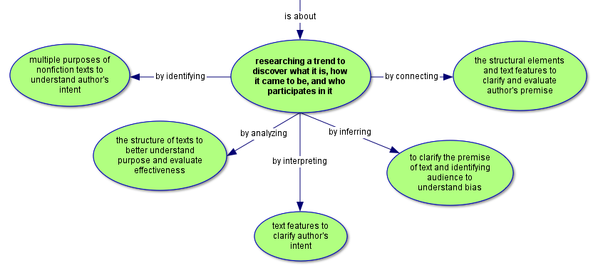
Unit plan
Notes:
Refer to your grade level unit. Look at the unit template.
Look at the graphic organizer for your grade level.
Look at the headings for each section in the overview (unit abstract, content expectations, essential questions, key concepts, assessment tasks, intellectual processes, lesson sequence, resources).
Point out paper clipped sections and the fact that you can access the materials by clicking on the paperclips.
What did you come to understand about this unit format? What lingering questions might you have?

Slide 34

Exploring the architecture of a mini lesson

Slide 35
Turn and talk
With an elbow partner, turn and talk about what you noticed regarding the flow of the mini-lesson segments.
Be ready to share with the whole group.

Slide 36
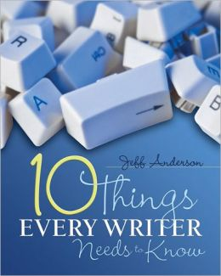
http://www.stenhouse.com/html/andersontenthings.htm?r=n230w

Slide 37
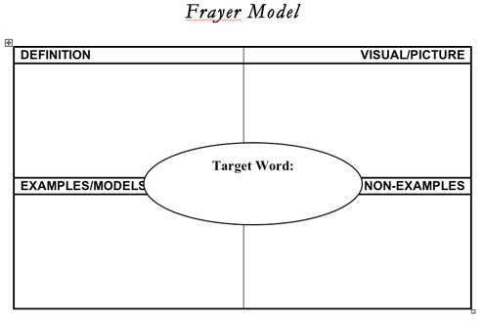
prologue
Notes:
Complete for the word, “writing” What is writing? What isn’t it?

Slide 38

Divide into groups (5)
Read your assigned section
Activity: Key Concept Synthesis note taker
Notes:
Chunking the text…do the first 5 chapters. Need to figure out how to chunk the text…maybe put a number inside the colored dots (1-5)
Could use the “Key Concept Synthesis” note taker for during reading activity.

Slide 39
Key concept synthesis
Chapter 1: Motion
Chapter 2: Models
Chapter 3: Focus
Chapter 4: Detail
Chapter 5: Form
Notes:
Make copies of the graphic organizer for teachers to use to record thoughts as they read their assigned chapter.
How could I use, adapt or differentiate it?
If this is a new strategy for your students, it is helpful to make copies of a section of the text so that they can highlight and annotate; this process alone will encourage a close reading of the text even before they complete the graphic organizer.
When first using this strategy with your students, you may want to have them identify the various elements that helped them to zero in on the main ideas or key concepts. This could be noted in the Key Concept column under the concept or in the margins of the annotated text.
For students that are more visual and/or artistic, they may want to use a mind map to capture the key concepts and their connections.
Once students have completed the graphic organizer, they can share their ideas with other students to discuss how/why they identified the key concepts they selected.
Chart paper: “Key” cutout to record 5 ideas for each chapter. Groups can then share out to the larger group.

Slide 40
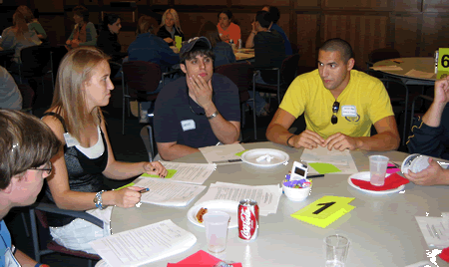
Save the last word for me
Notes:
The strategy has six parts:
Reading the text
Writing important parts
Personal reflection
Small group discussion
Ordering the cards/discussion points
Reading and reacting to the cards
This strategy requires students to read a text and record five statements from it that they find interesting or significant. After each statement, they record their own comments about the statements. The strategy is used to stimulate students to reflect on what they read, develop active and thoughtful readers, encourage students to talk about what they read, allow students to participate in a discussion, elicit differing opinions or multiple interpretations from a text.

Slide 41

skitch
Notes:
Think about whether or not I could show how to use this tool with a piece of online text.

Slide 42
Informational text resources
http://vms.vale.k12.or.us/articles-week
http://learning.blogs.nytimes.com/2011/06/14/the-times-and-the-common-core-standards-reading-strategies-for-informational-text/?nl=learning&emc=learninga1
http://www.readingtothecore.com/resources.html

Slide 43
Topics for next meeting?
April 18th, 12:30-3:30
Read chapters 6-10 for homework

Slide 44
Power of Words…
http://www.youtube.com/watch?v=Hzgzim5m7oU

Slide 45
Next meeting
Read chapters 6-10

